Slide 1

Patient Health Analysis

Slide 2
01
Patient Demographics
02
DataBase Schema
CONTENTS
03
DeskTop Application
04
Team Member

Slide 3
01
Patient Demographics
Description of each column in the dataset

Slide 4

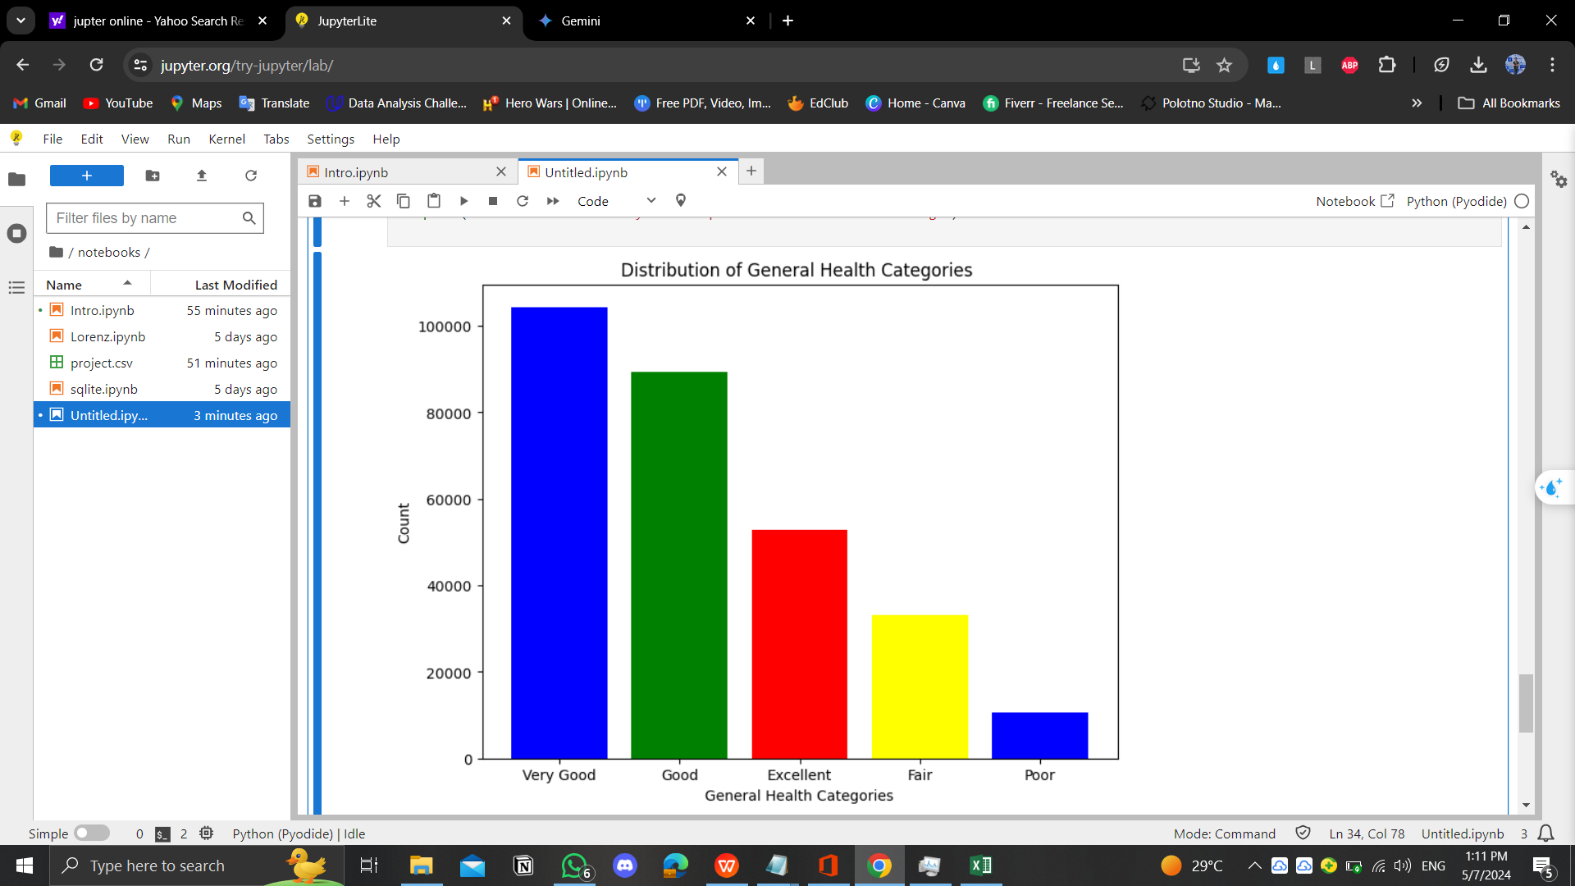
General Health
General Health
Refers to the state of an individual's overall health, and includes factors such as nutrition, exercise, sleep quality, stress management, and practicing daily healthy habits. It contains
Values
Poor,
Fair,
Good,
Very Good,
Excellent

Slide 5
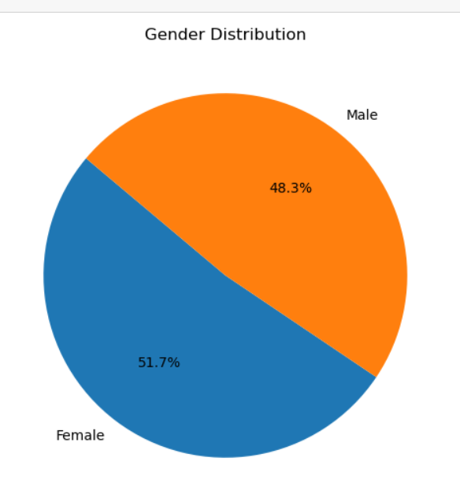
Gender
Gender can actually affect prognosis due to biological differences and sex-specific lifestyle choices. For example, heart disease tends to be more common in males, while skin cancer is more common in females. This may result from factors such as differential exposure to risk factors or discrepancies in life expectancy between the sexes.
Values
Male 48.3 %
Female 51.7 %

Slide 6
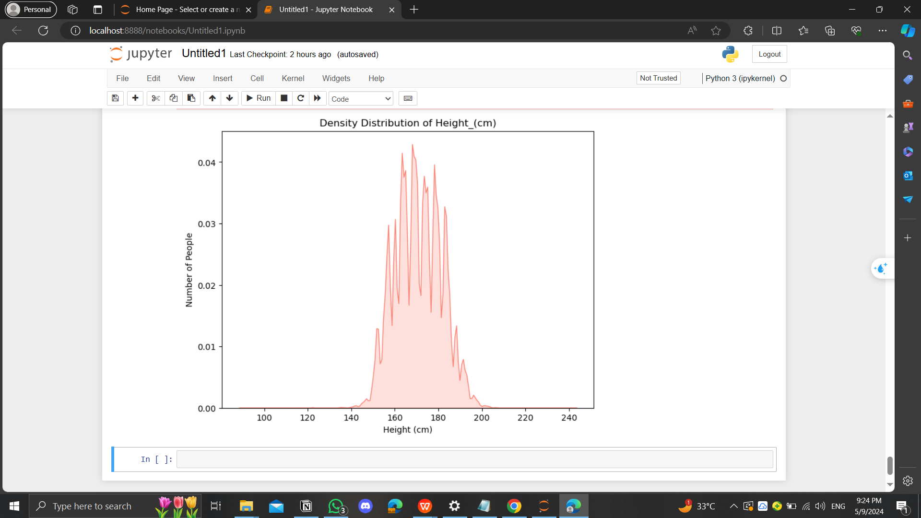
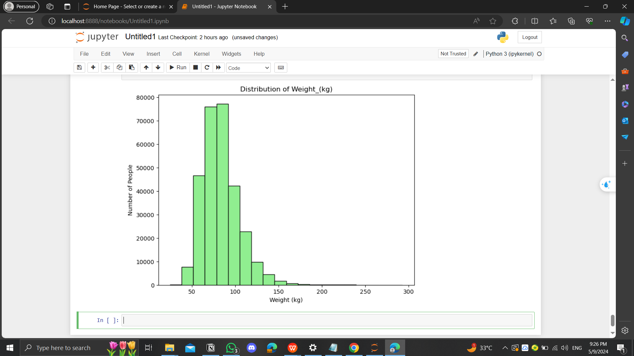
Height (cm)
Weight (kg)
This PPT template for the rice husk designer pencil demo works, focusing on the production
This PPT template for the rice husk designer pencil demo works, focusing on the production

Slide 7
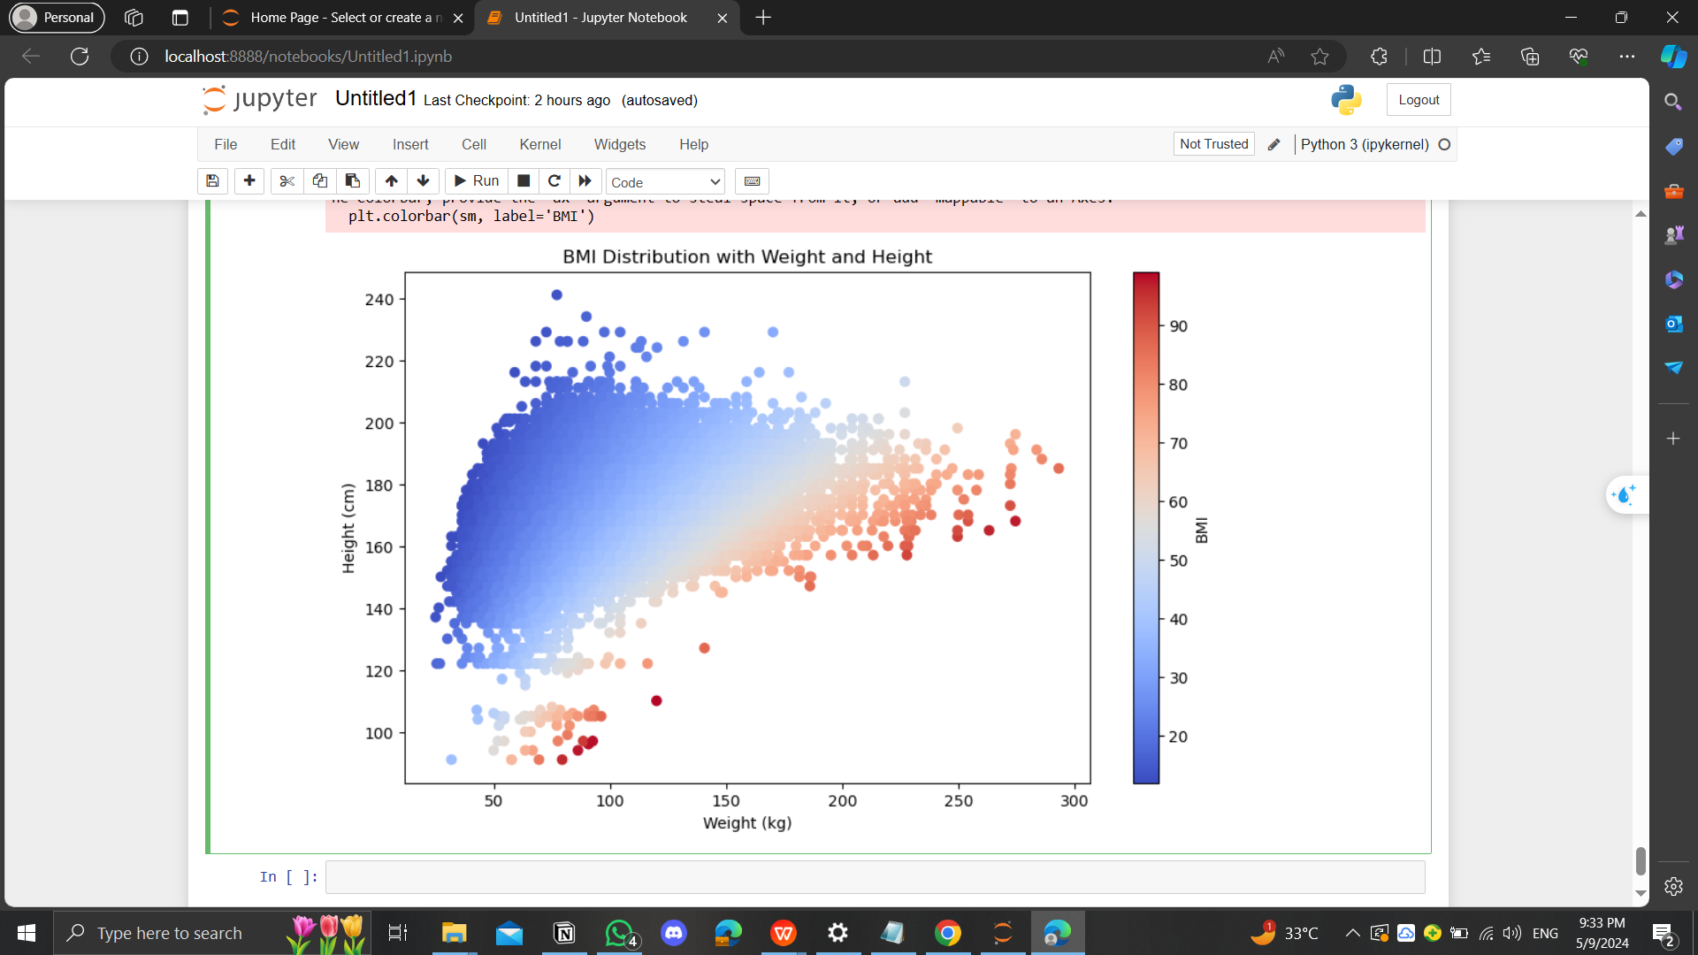
BMI (Height - Weirht)

Slide 8
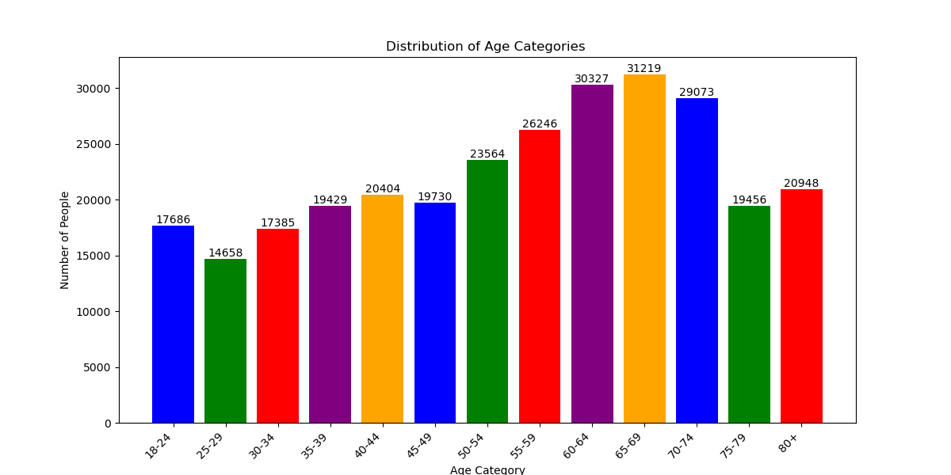


Age Category
Add Your Title
This PPT template for the rice husk designer pencil demo works, focusing on the production
This PPT template for the rice husk designer pencil demo works, focusing on the production
20XX
20XX

Slide 9
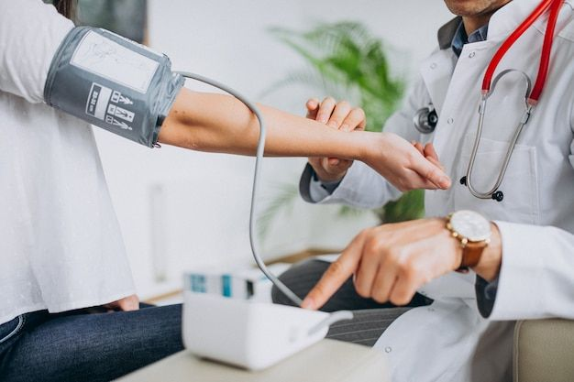
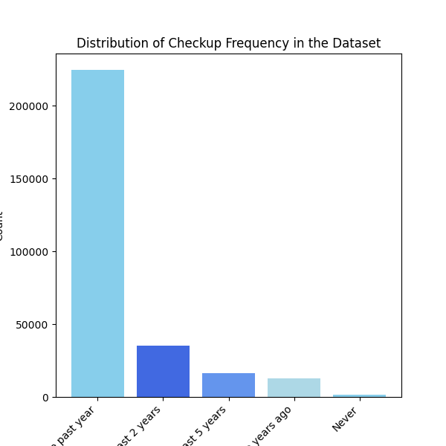

Checkup
Regular health checkups help in early detection and management of diseases, and improve prognosis.s
Values
5 or more years ago
Within the past 2 years
Within the past 5 years,
Within the past year
Never

Slide 10

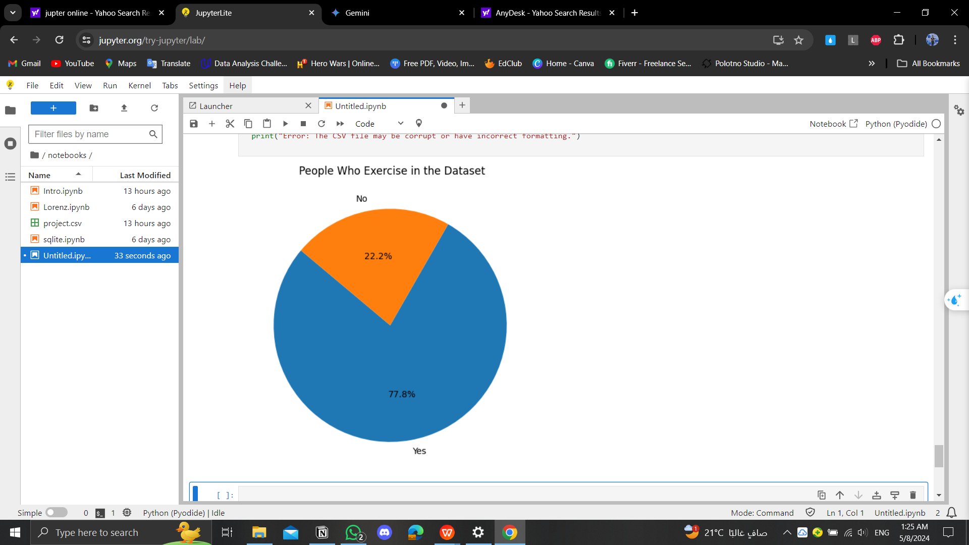
Exercise
Refers to the state of an individual's overall health, and includes factors such as nutrition, exercise, sleep quality, stress management, and practicing daily healthy habits. It contains
Values
Yes 77.8%
No 22.2%

Slide 11
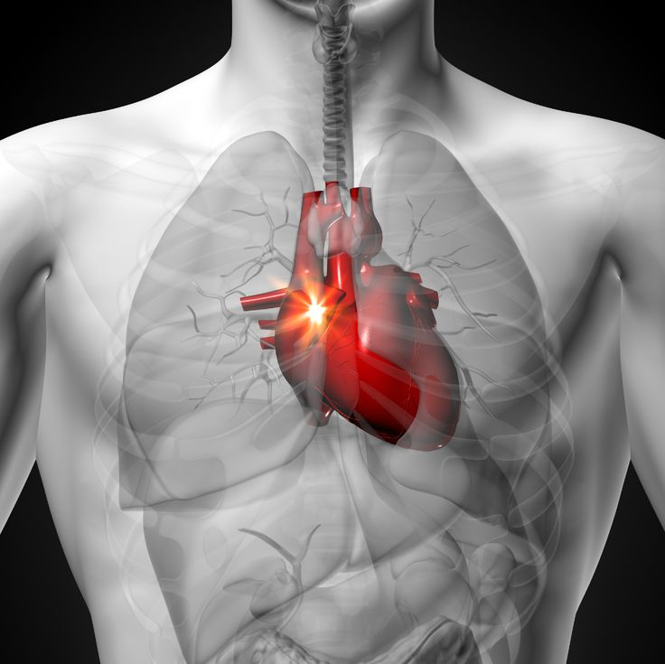
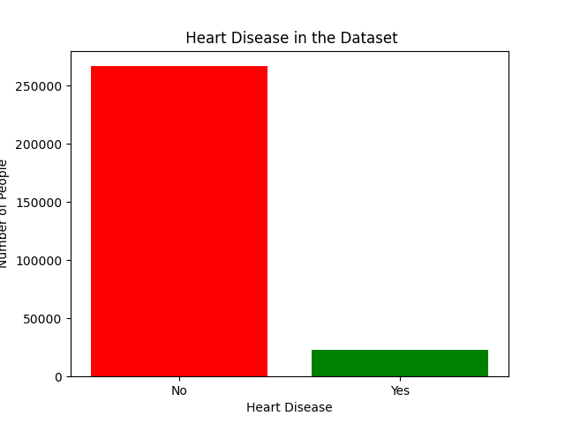
Heart Disease
includes a group of conditions that affect the heart, such as atherosclerosis and heart failure. It is caused by factors such as genetics and lifestyle. It is necessary to prevent it by following a healthy diet, exercising, and avoiding smoking. If the value is "no," then there is no disease; if "yes," then it exists
Values
Yes 8.01%
No 91.99%

Slide 12
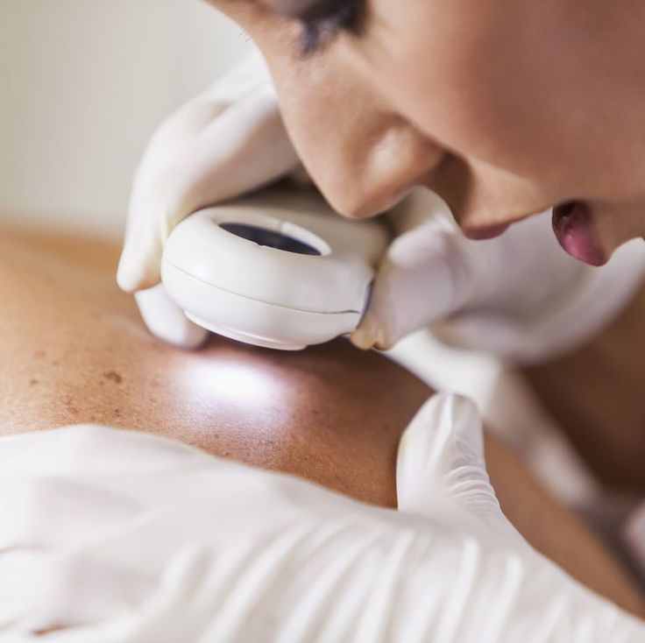
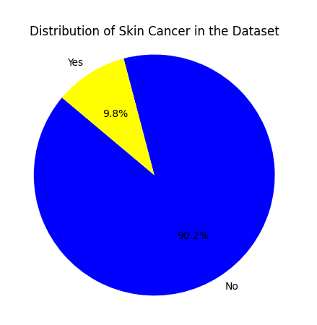
Skin Cancer
Abnormal growth of skin cells as a result of exposure to sunlight. Prevention: Use sunscreen and conduct regular skin checks. If the answer is "no", then there is no disease; If yes, then the disease is present.
Values
Yes 9.80%
No 90.20%

Slide 13
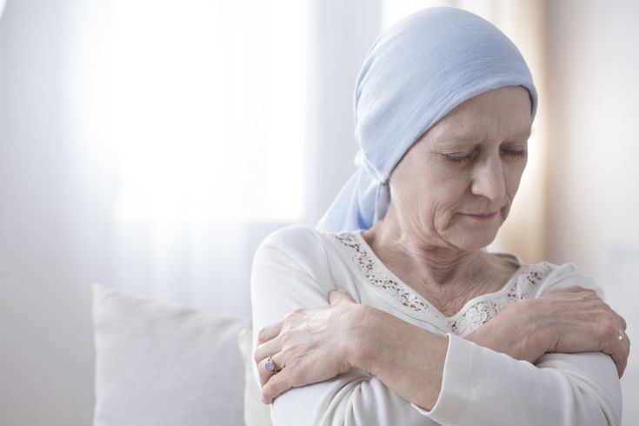
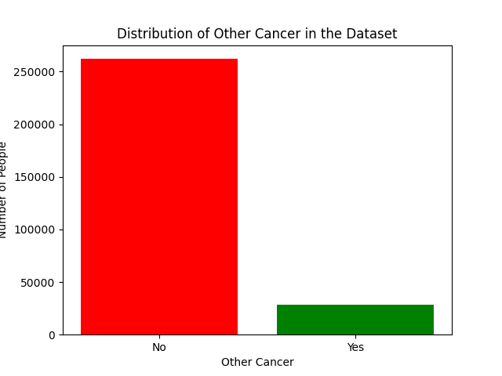
Other Cancer
Other cancers encompass various types affecting different body parts like breast, lung, and carcinoma. If "no," no disease; if "yes," disease exists.
Values
Yes 9.69%
No 90.31%

Slide 14
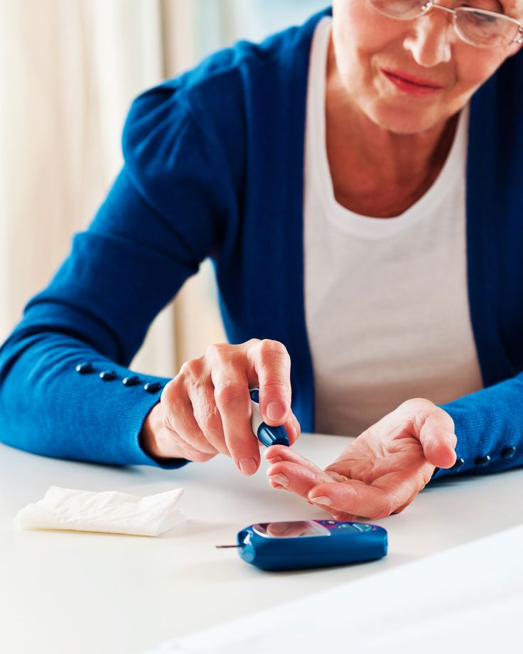
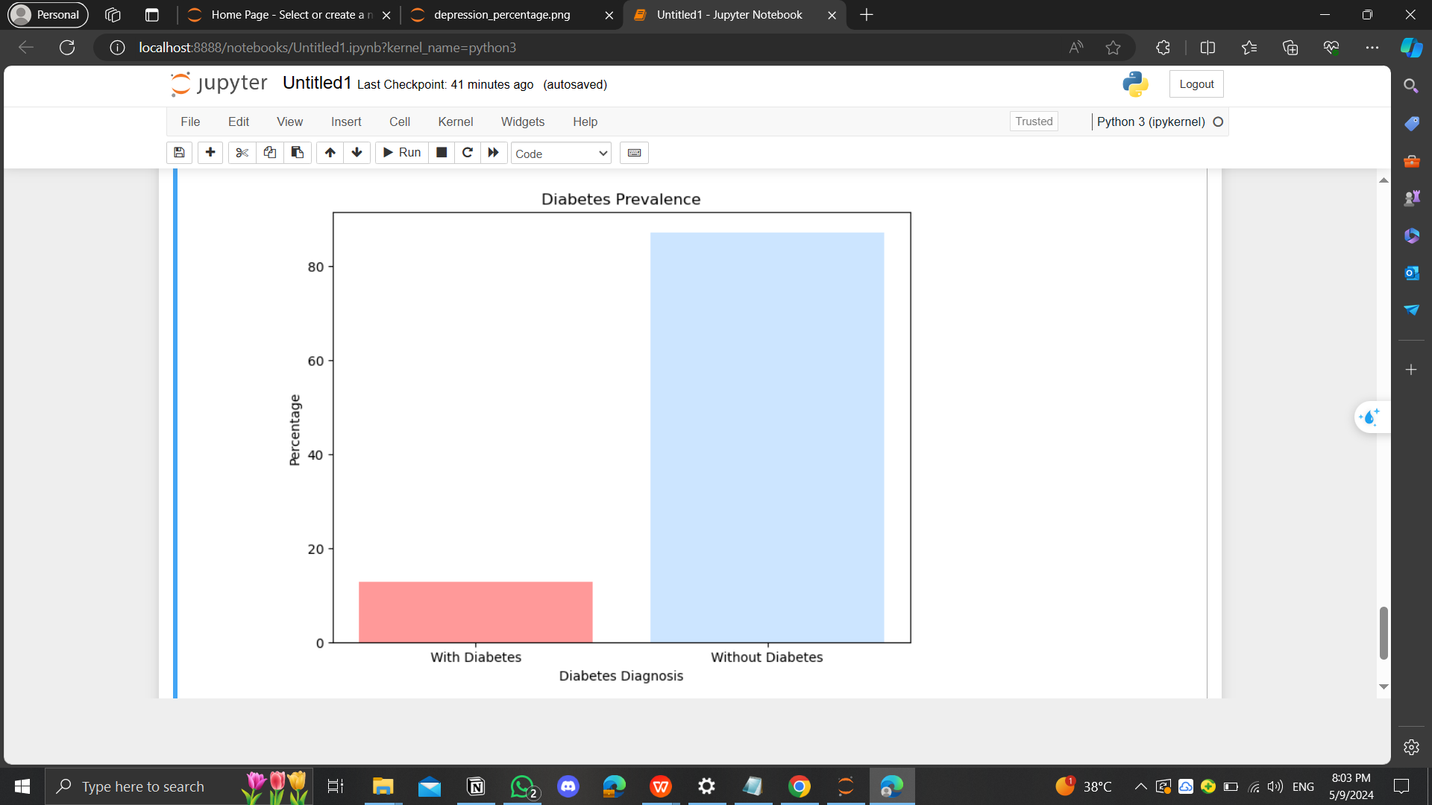
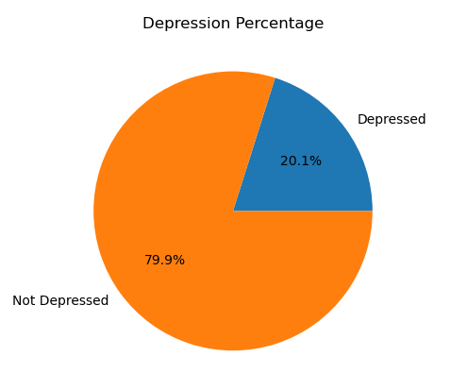
Diabetes
High blood sugar due to insulin problems. Treatment: diet, exercise, medications, insulin injections. If the answer is “no,” then there is no disease; If yes, then there is a disease. During pregnancy, check only then. And “no pre-diabetes.”
Values
Yes 12.88%
No 87.12%

Slide 15
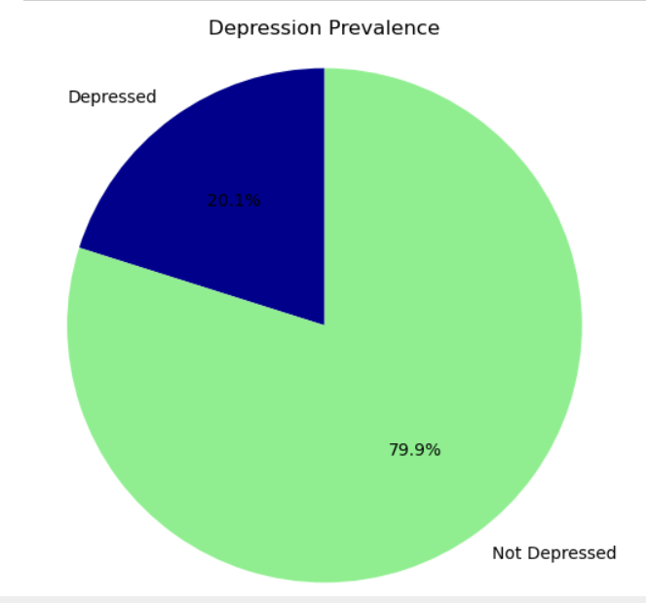
Depression
A psychological condition characterized by deep sadness, loss of interest in daily activities, and fatigue. Treatments include psychological counselling, medications, and lifestyle changes. If the value is "no", then there is no disease; If yes, then it exists.
Values
Yes 20.12%
No 79.88%

Slide 16
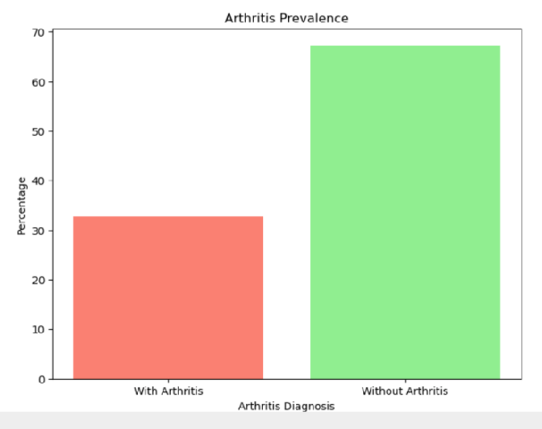
Arthritis
Joint swelling and pain. Caused by wear and tear or arthritis. Treated with anti-inflammatory meds, therapy, lifestyle changes. If "no," no disease; if "yes," disease exists.
Values
Yes 32.66%
No 67.34%

Slide 17
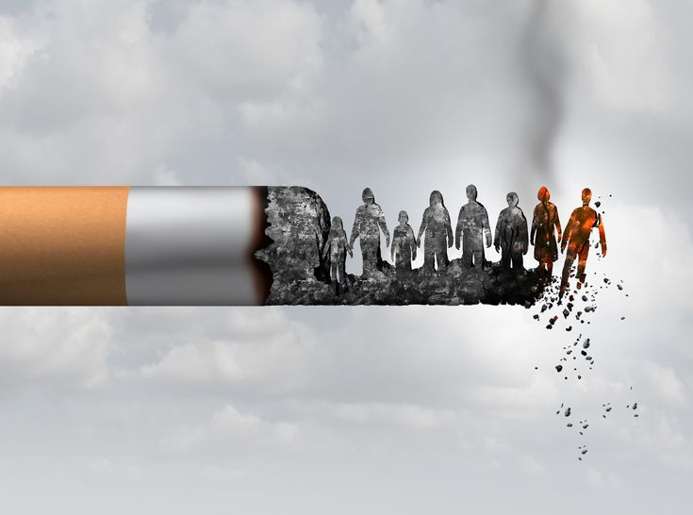
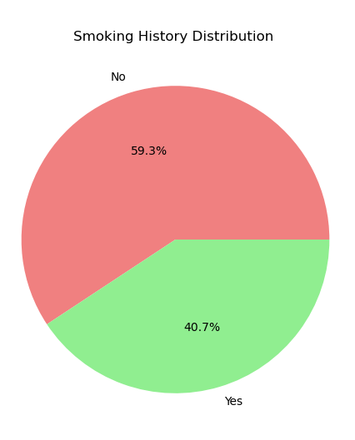
Smoking History
Smoking increases disease risk by damaging blood vessels, raising blood pressure, and reducing organ oxygenation. If the value is "no," then there is no disease; if "yes," then it exists
Values
Yes 40.70%
No 59.30%

Slide 18
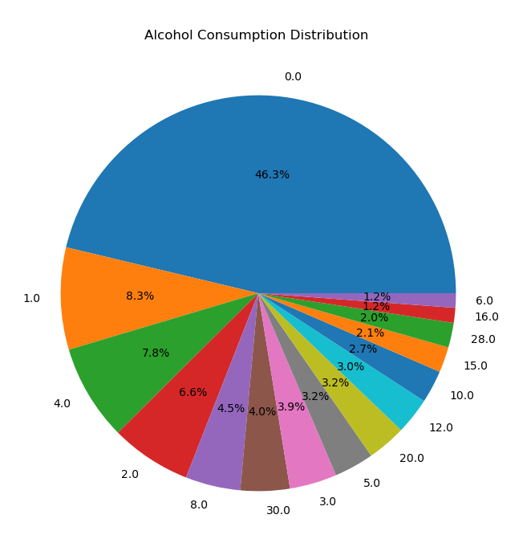
Alcohol consumption
Consuming alcoholic beverages, which can be in various quantities and concentrations, which may affect public health and safety.

Slide 19
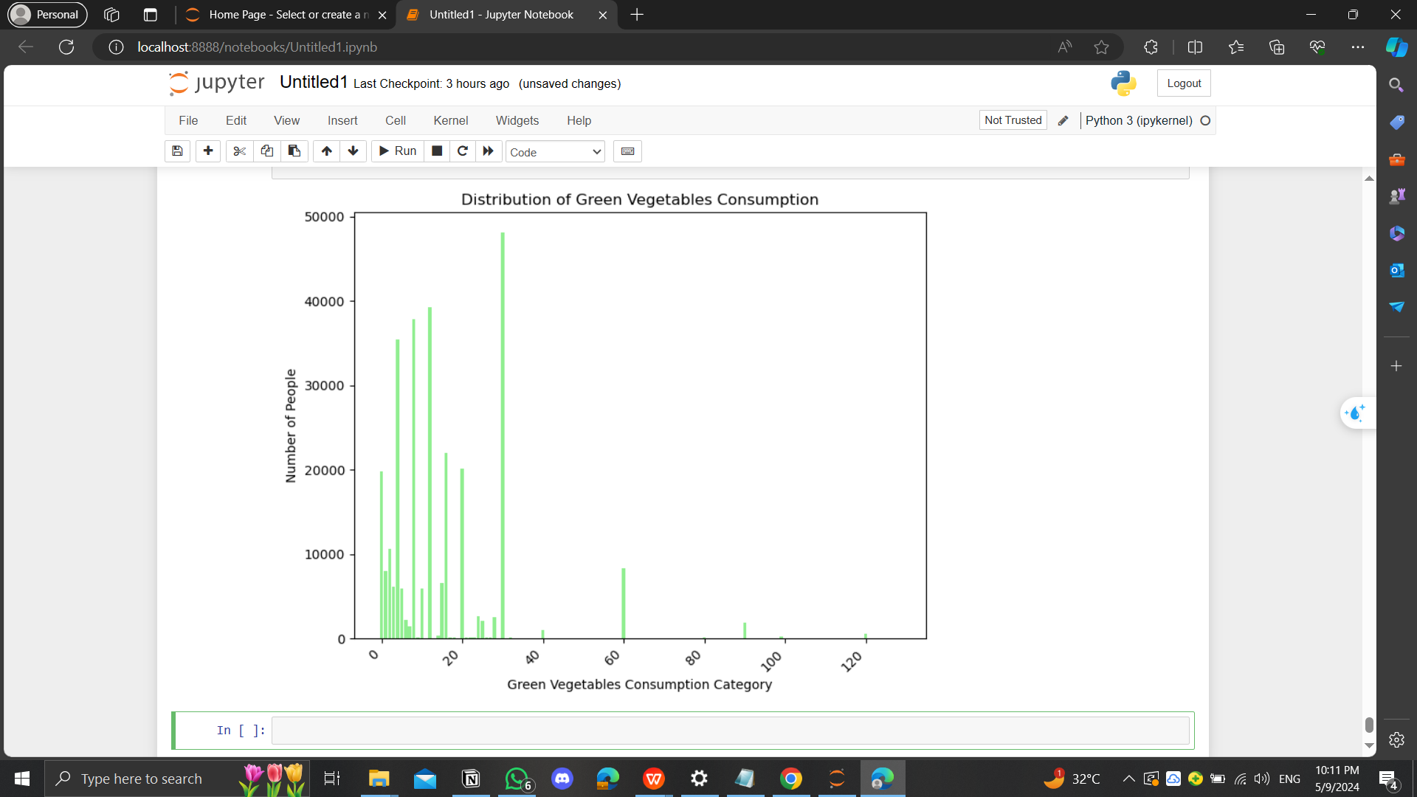
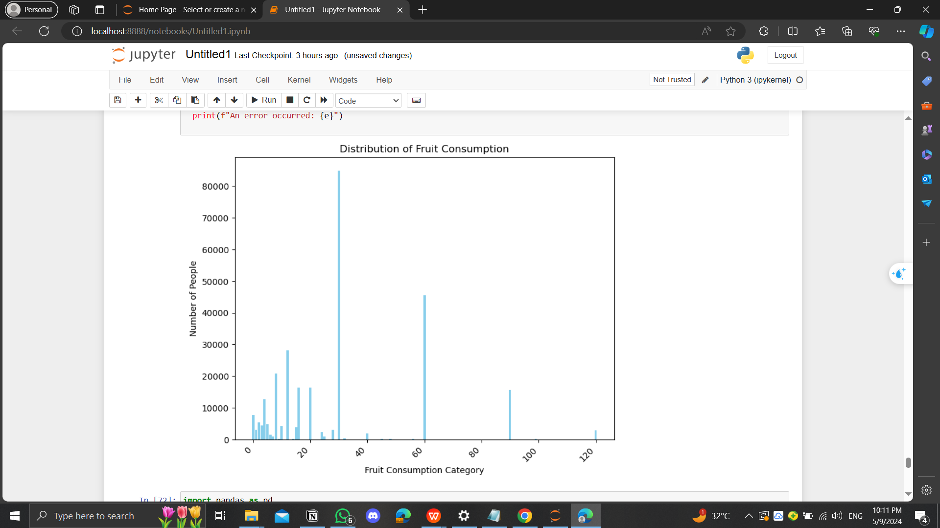
Vegetables Consumption
Fruit Consumption
This PPT template for the rice husk designer pencil demo works, focusing on the production
This PPT template for the rice husk designer pencil demo works, focusing on the production

Slide 20
02
DataBase Schema

Slide 21
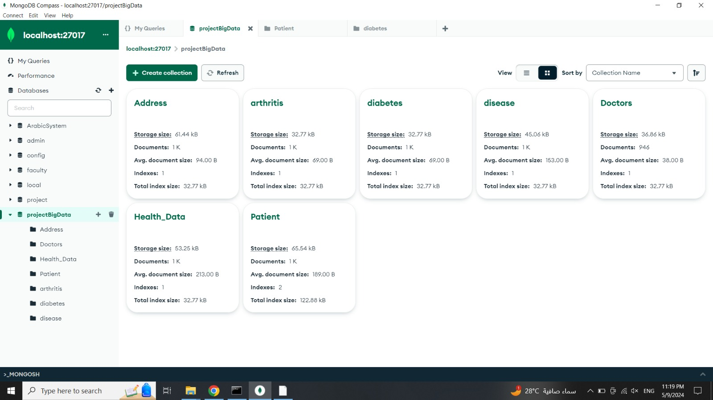
DataBase Schema

Slide 22
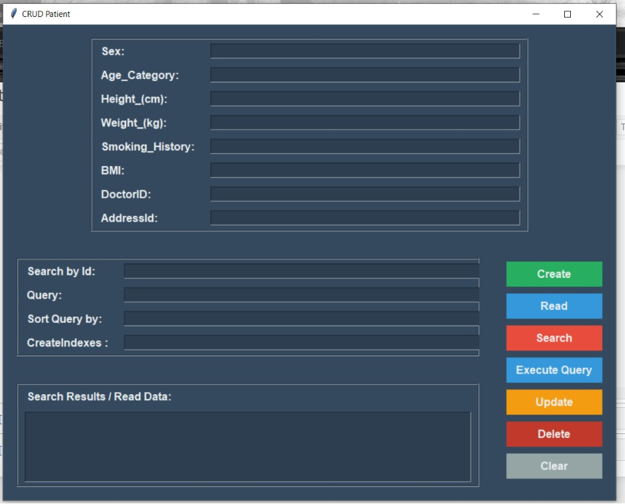
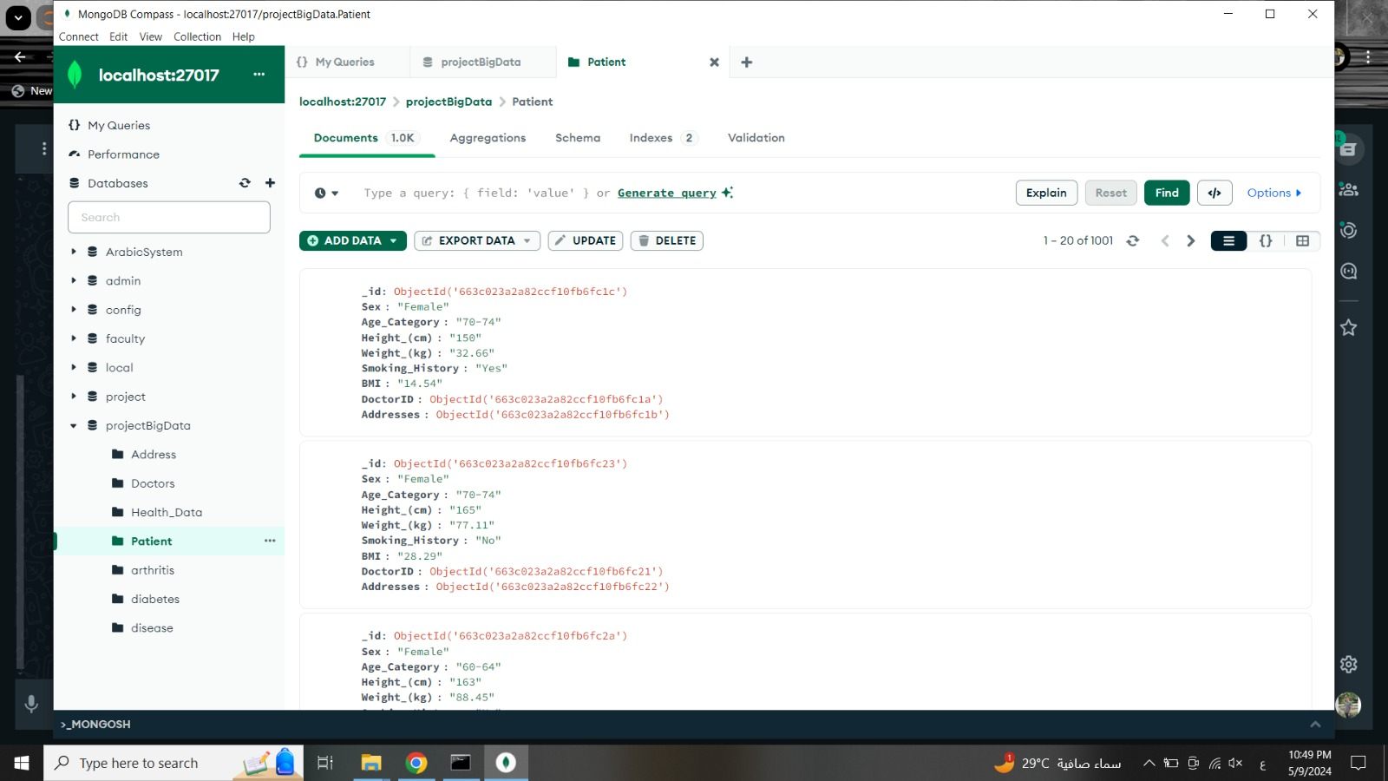
1
Patient

Slide 23
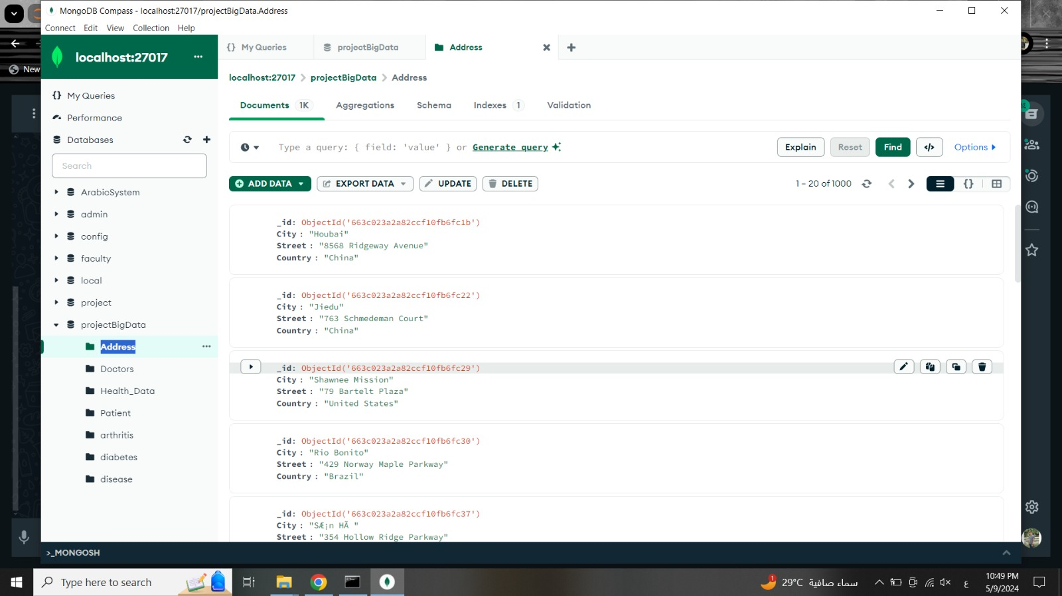
1
Address

Slide 24
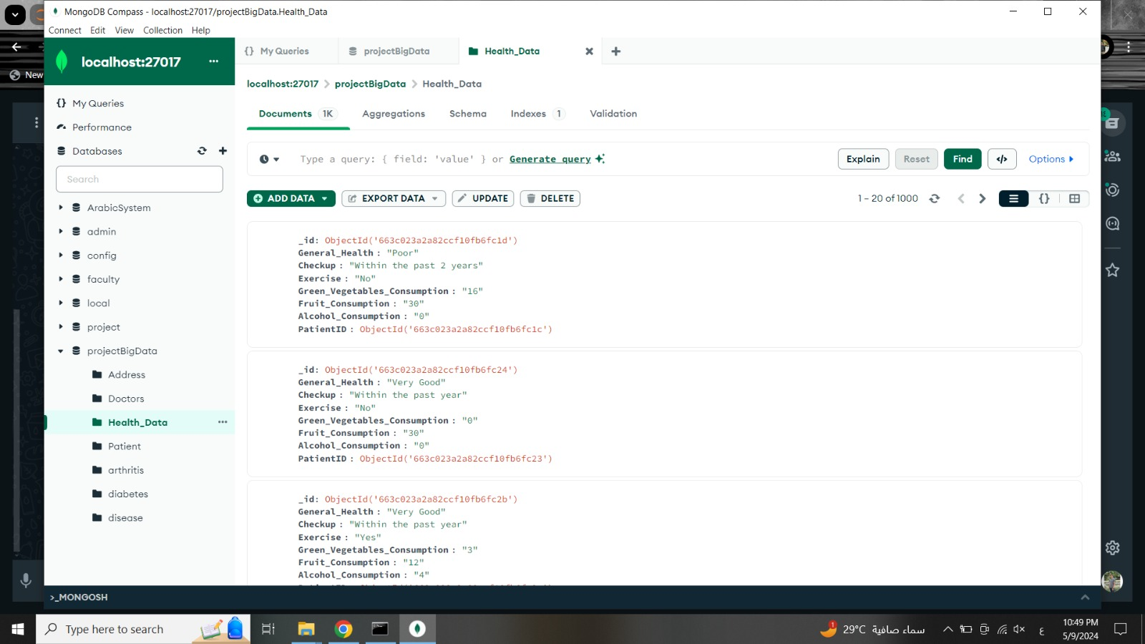
1
Health Data

Slide 25
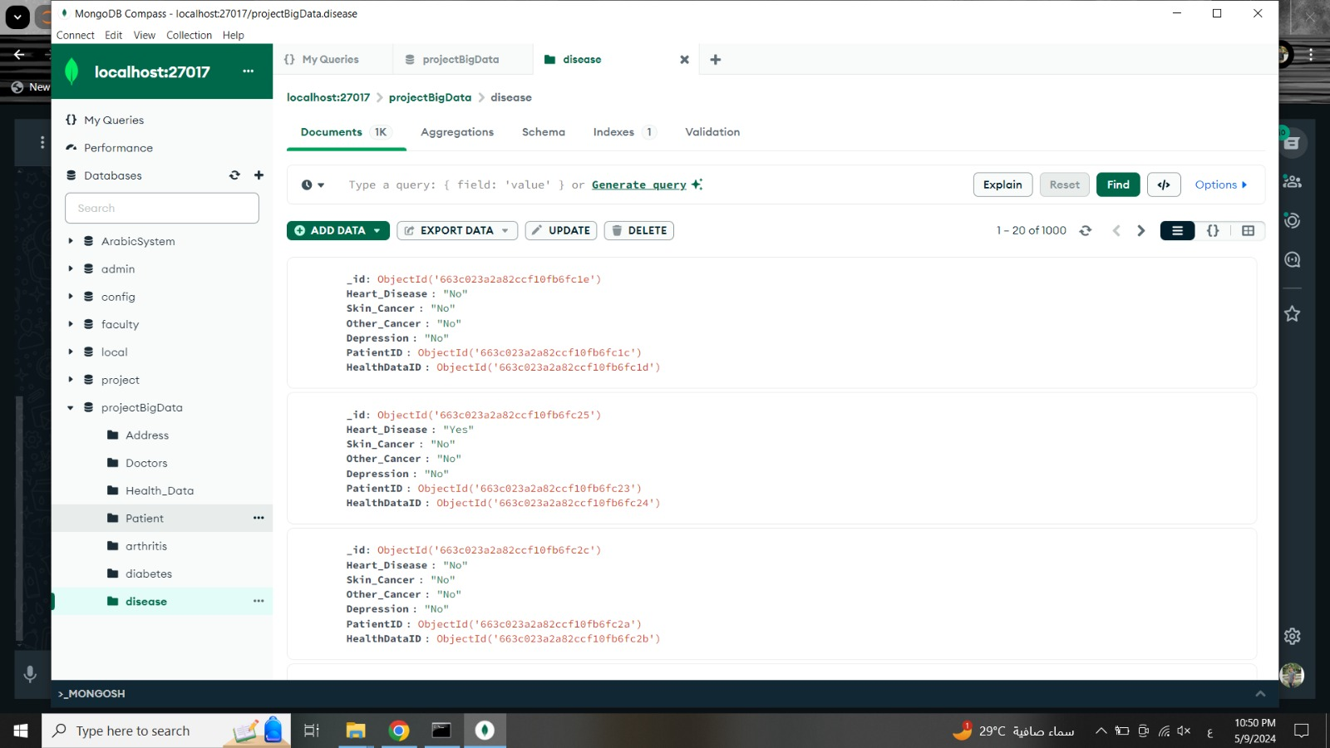
1
Disease

Slide 26

1
Diabetes

Slide 27

1
Arthritis

Slide 28
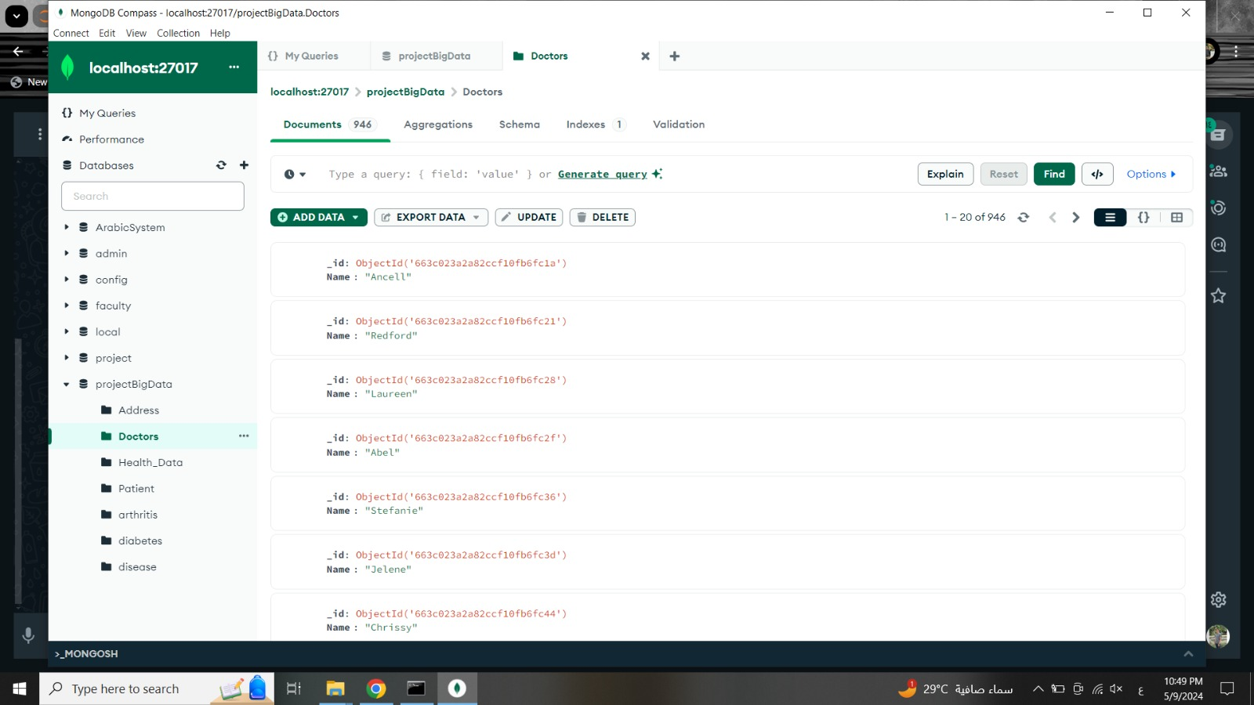
1
Doctor

Slide 29
03
Desktop Application

Slide 30
Application Interfaces
1
2
3
4
Patient
Doctor
Health Data
Disease
5
6
7
Diabetes
Arthritis
Address

Slide 31
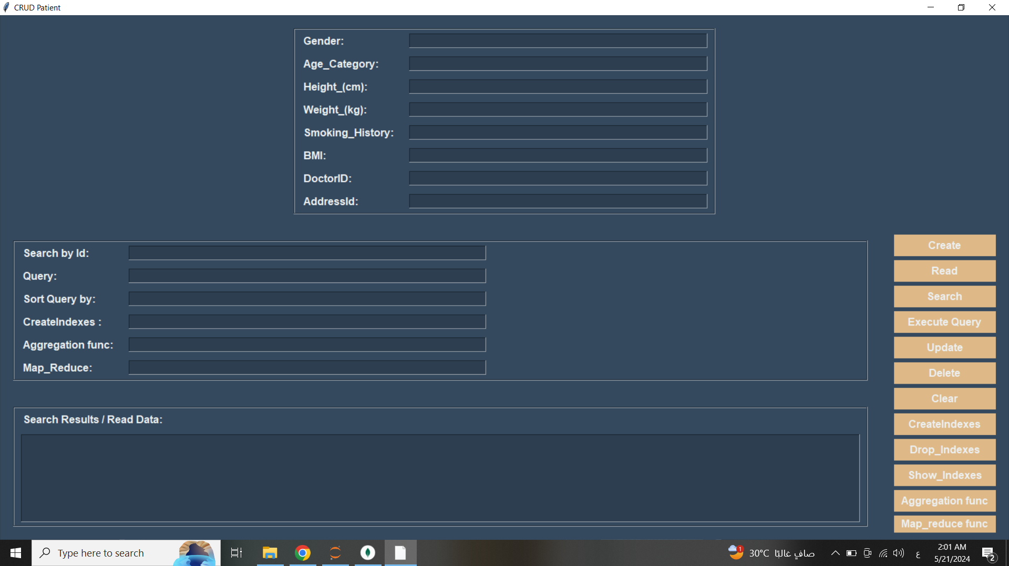
1
1
Patient

Slide 32
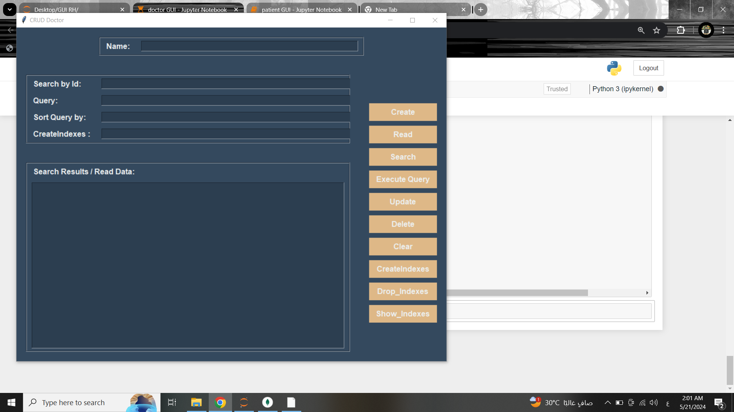
1
2
Doctor

Slide 33
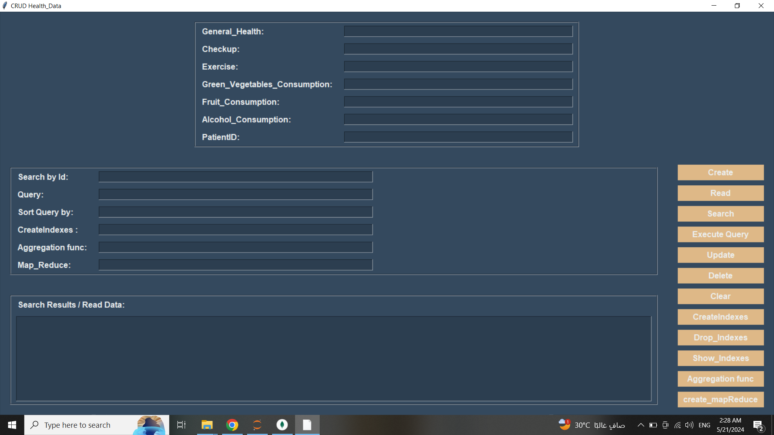
1
3
Health
Data

Slide 34
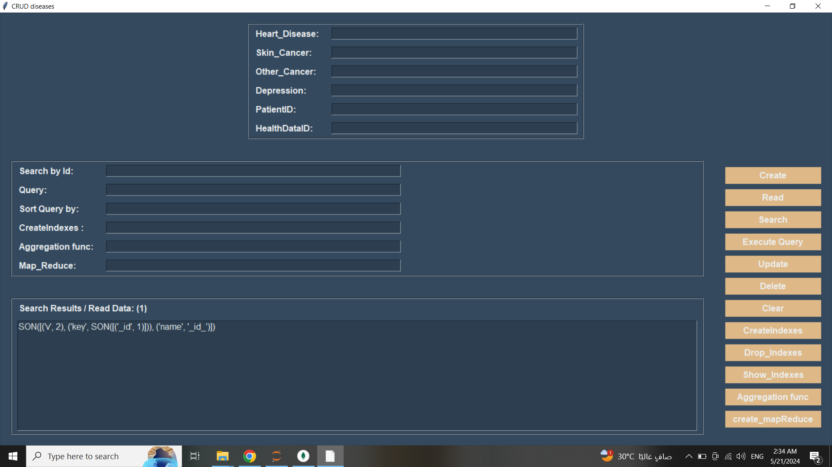
1
4
Disease

Slide 35
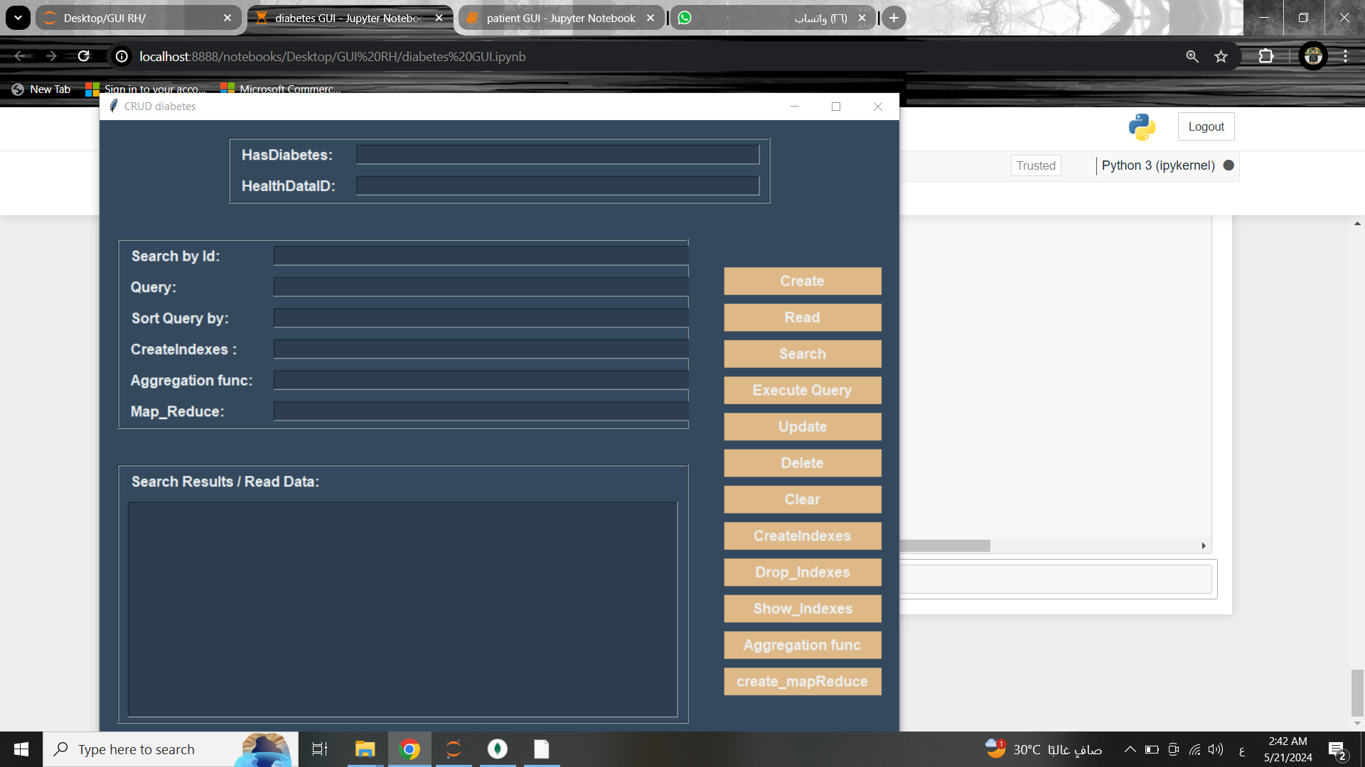
1
5
Diabetes

Slide 36
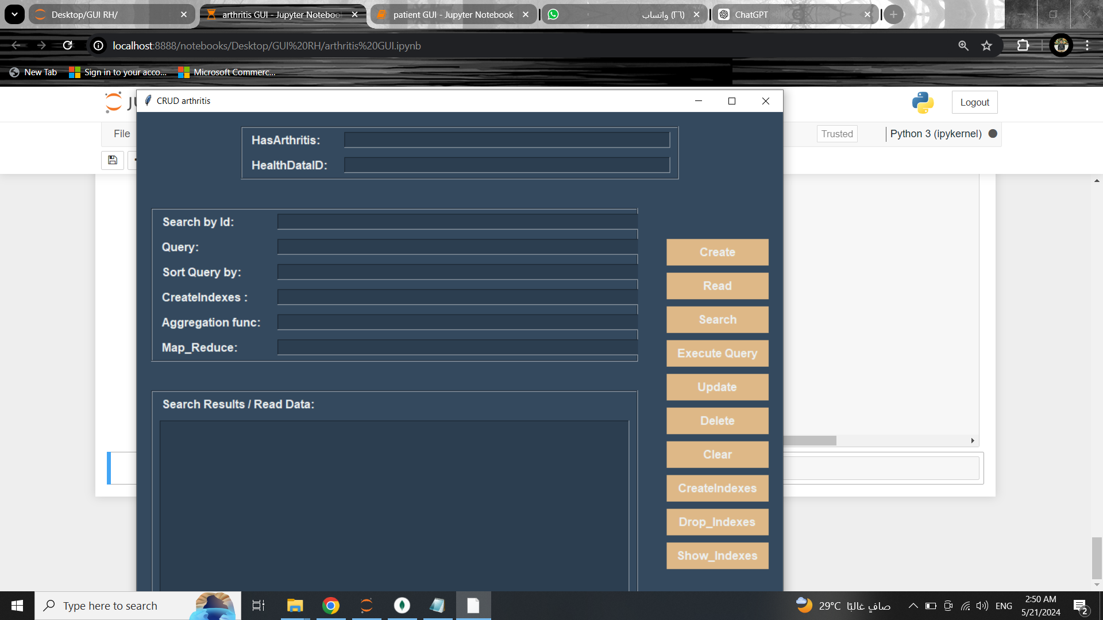
1
6
Arthritis

Slide 37
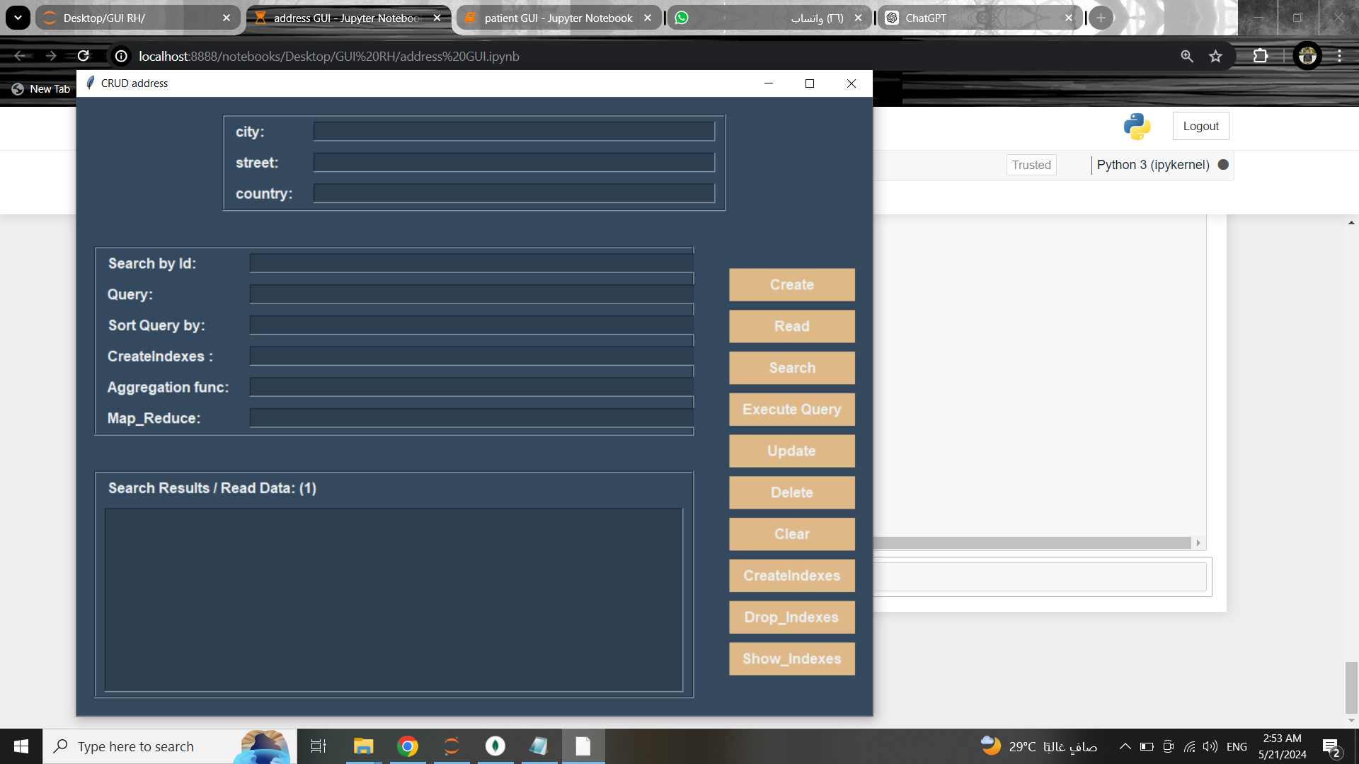
1
7
Address

Slide 38
04
Team Member

Slide 39
Supervisor
Dr. Taysir Hassan Abdel Hamid
Eng . Mena Nagy
Eng. Rofida Gamal
Team Member
* Mostafa Ashraf Ali Ahmed * Mahmoud Hussien mohamed Ahmed
* Mohamed Ali Rajab Ali * Mahmoud Mohamed Abdelhaleem Ali
* Shrouk sobhy Abd alsabour ali * Salma Hamada Abdel Naeem Mohamed

Slide 40
Thank You

